Slide 1

How to influence decision-making within the planning ecosystem at a local level.
Simon Thomas
Community Planning Alliance
Thursday 7th September 2023

Slide 2
Contents
Local Government
What ?
Who ?
How ?
Summary
Q&A

Slide 3

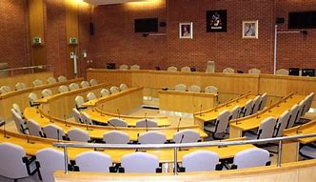
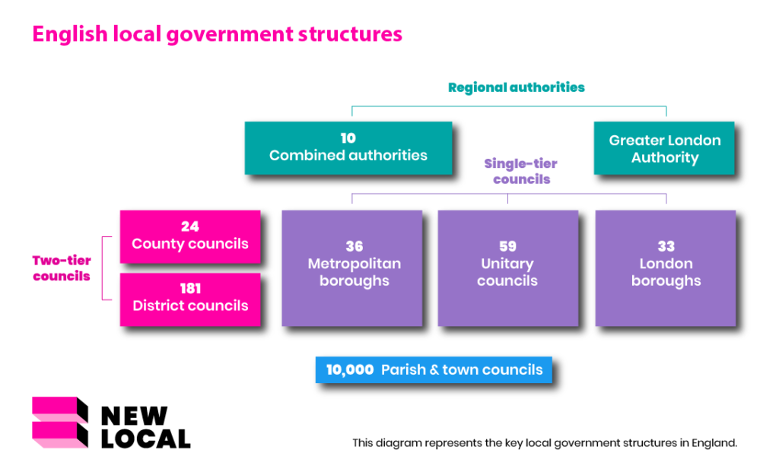
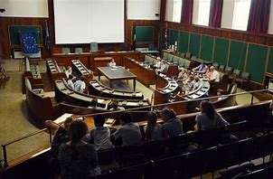
Perception & Reality
Different structures and levels of competence
  One, two or three tier
  Devolution and Levelling Up (or down)
Urban Mayoralities – Unitaries – County – District/Borough – Town/Parish
National Political Parties at most levels, with growing Independents and Residents Parties (often single issue)

Slide 4


National & Local Planning Policies
Local Government Act / Localism Act
Town & Country Planning Act
NPPF
PPG
Local Plan
Supplementary Planning Documents
Neighbourhood Plan
Design Statement / Guidelines
+ LURB on its way
STATUTORY RESPONSIBILITIES

Slide 5

- LOCAL PLAN ?
National
DLUC
PLANNING INSPECTORATE
MP
QUANGOS
QUANGOS
LOBBYING GROUPS
LOBBYING GROUPS
Policy
Decisions
Consultation
COUNTY OFFICERS
COUNTY COUNCIL CABINET
LAND & DEVELOPMENT PROMOTERS
LPA CABINET
COUNTY COUNCILLORS
LPA OFFICERS
DEVELOPERS
LPA DEVELOPMENT POLICY COMMITTEE
LANDOWNERS
LPA WARD COUNCILLORS
NEIGHBOURHOOD PLAN
PARISH COUNCIL
CAMPAIGN GROUPS
Local
RESIDENTS

Slide 6
– APPLICATION ?
National
PLANNING INSPECTORATE
(APPEALS)
MP ?
QUANGOS
LOBBYING GROUPS
Policy
Decisions
Consultation
COUNTY OFFICERS
LAND & DEVELOPMENT PROMOTERS
LPA CABINET
LPA OFFICERS
COUNTY COUNCILLORS
DEVELOPERS
LPA PLANNING COMMITTEE
LANDOWNERS
LPA WARD COUNCILLORS
NEIGHBOURHOOD PLAN
PARISH COUNCIL
CAMPAIGN GROUPS
Local
RESIDENTS

Slide 7

When ?
Get ahead of the curve
Anticipate scenarios
Set Priorities
Effectiveness
Impacts
Outcomes
Be adaptable & flexible

Slide 8



Collect information and acquire knowledge/skills
Understand each stakeholders’ objectives
Professional approach
Analyse and collect insights
Use material policies and factual accuracy
Offer solutions not just objections
Communicate & compromise, not confront & conflict

Slide 9
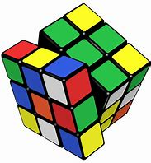
Summary
Every LPA is different, so is every Local Plan, and every application
Cllrs can change every four years, officers usually actually run things
Too many tiers and siloed departments
Too much self-interest often conflicting
Slow and confusion decision making, often behind closed doors
Use of technical ‘consultations’ as lip service
The system is broken but you have to work inside it.
Identify the influencers and decision makers
Communicate & compromise, don’t confront & conflict

Slide 10
Any Questions

Slide 11
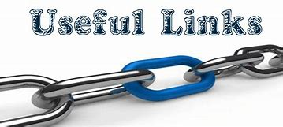

EXPLORE FURTHER
National Planning Policy Guidance (NPPG) | PlanningResource
planningresource.co.uk
Revised National Planning Policy Framework - GOV.UK
gov.uk
National Planning Practice Guidance | The Planner
theplanner.co.uk
National Planning Policy Framework - GOV.UK
gov.uk
Good Practice Guides - Planning Portal
planningportal.co.uk

Slide 12
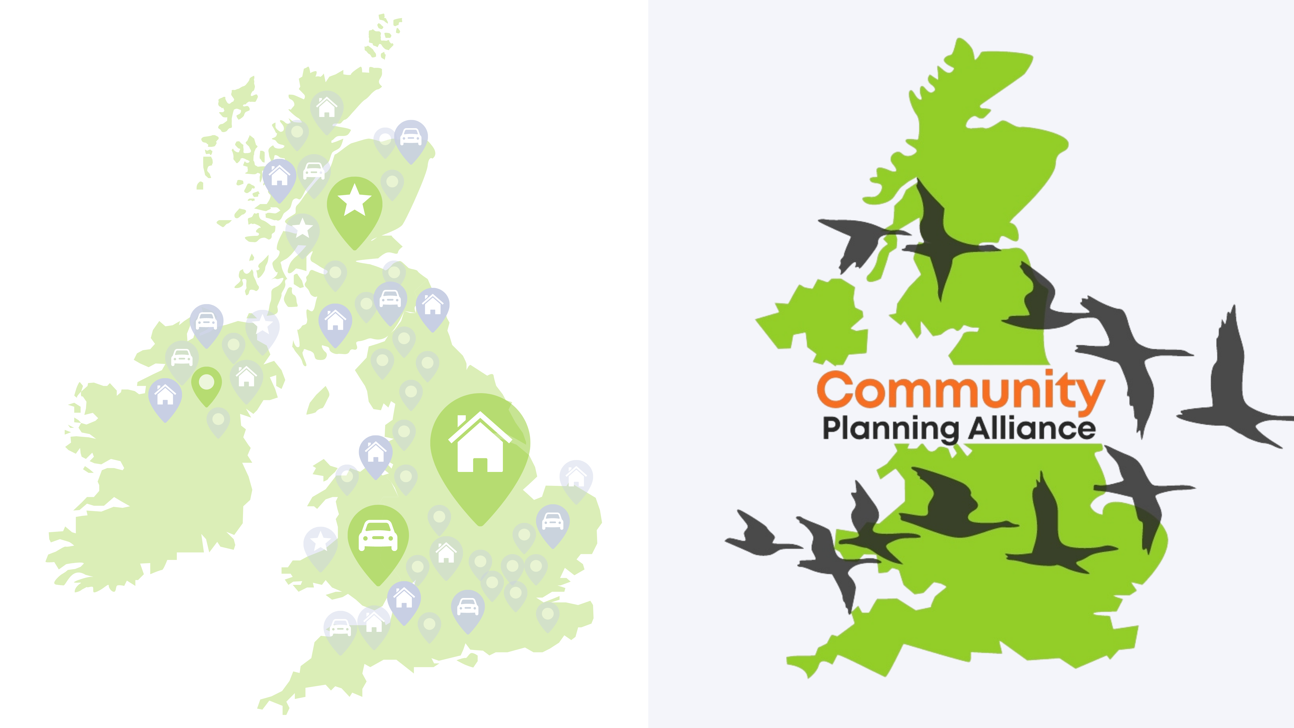
Thank you for listening

